Slide 1
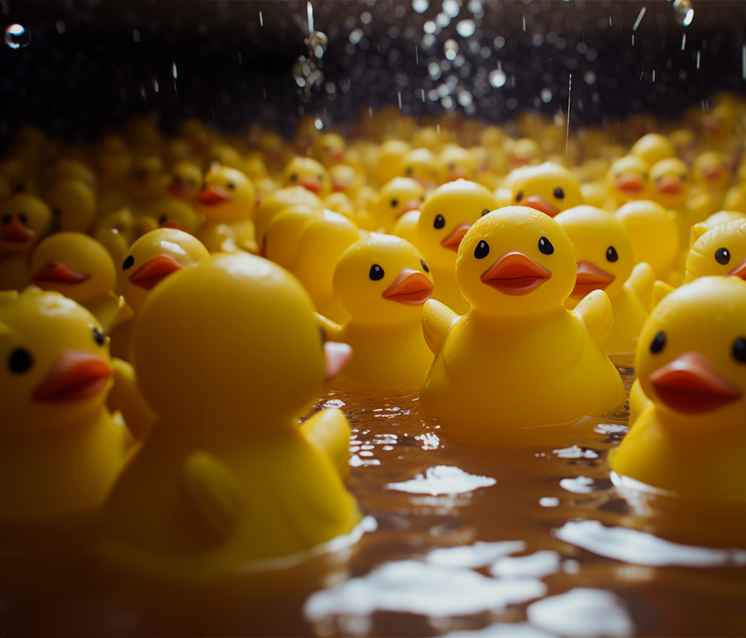
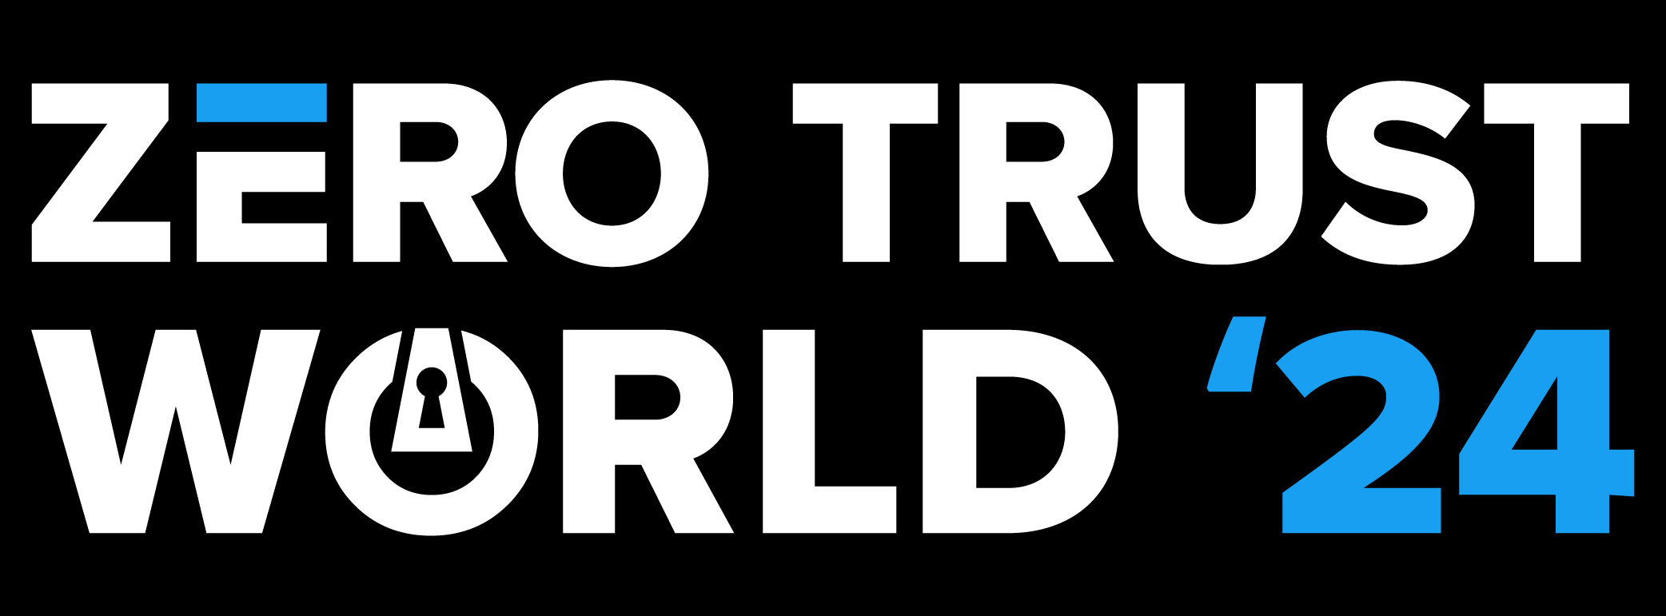
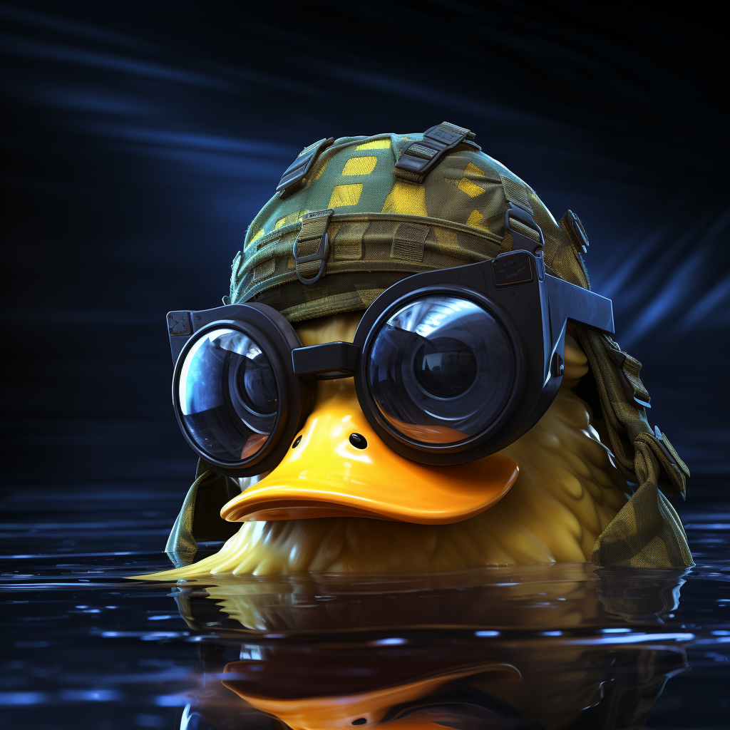
Advanced Ducky Class

Slide 2
Recap
You got your ducky.
You add stickers for the button on the ducky.
You got a hello world payload.
You ran the payload.
But Now What?

Slide 3
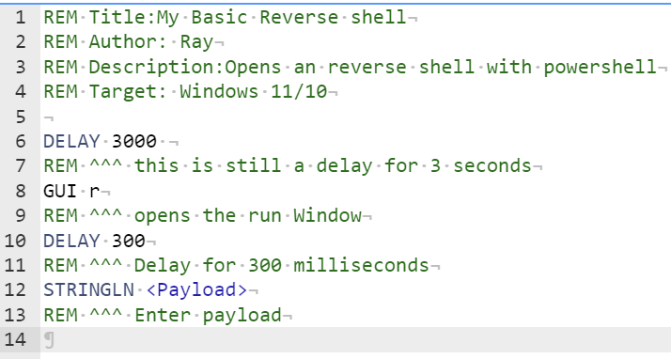
Basic Reverse Shell
No need to try to create this payload

Slide 4
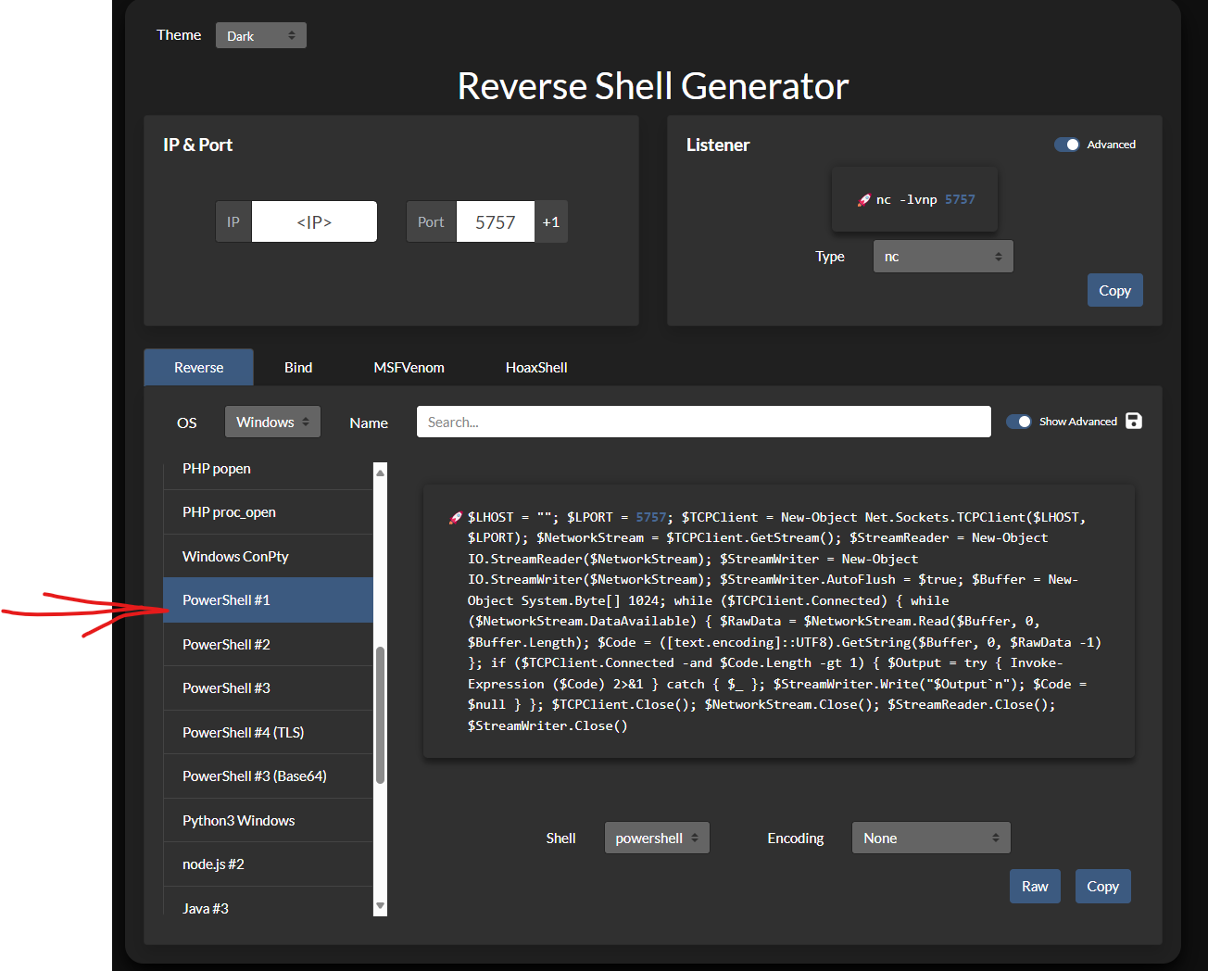
Getting the Payload
https://www.revshells.com/

Slide 5
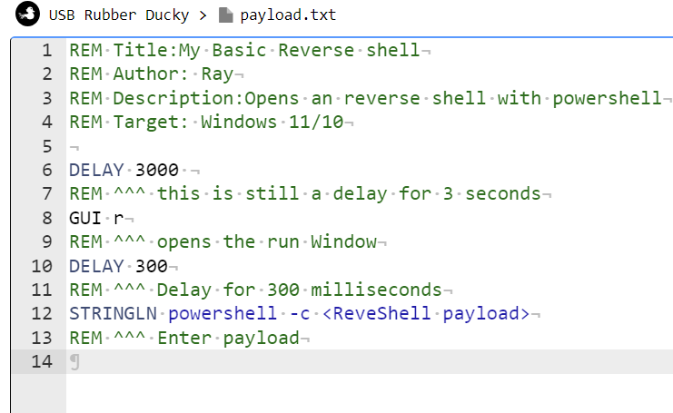

Adding the Payload to Basic Payload

Slide 6
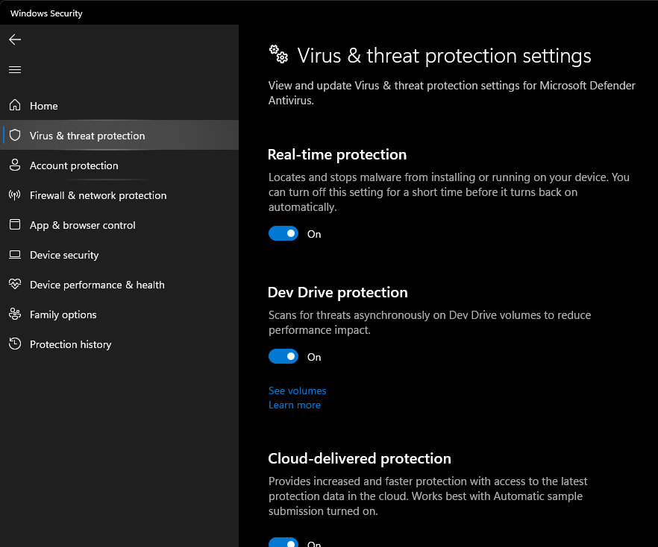
Why Doesn’t It Work?

Slide 7
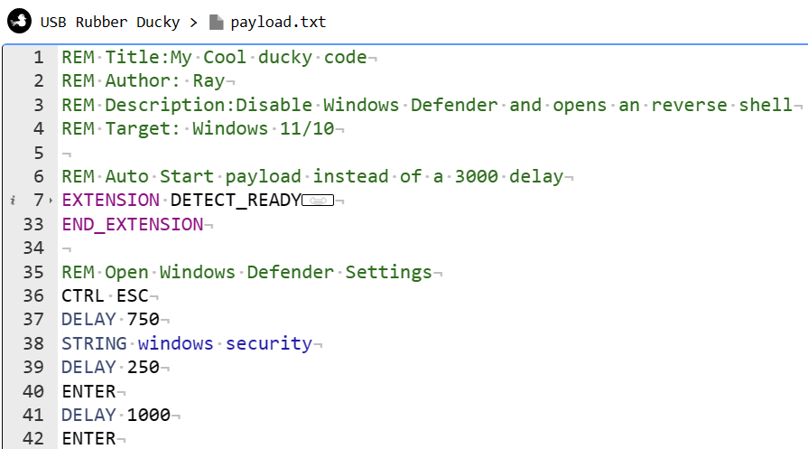
Advance Payload Time

Slide 8
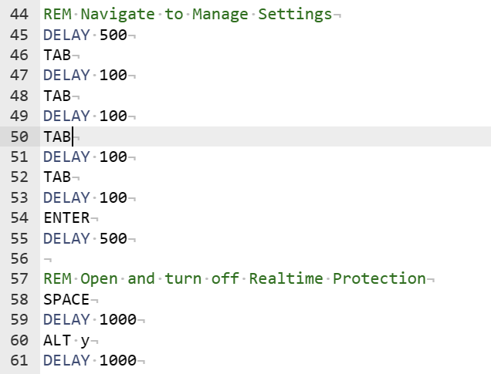
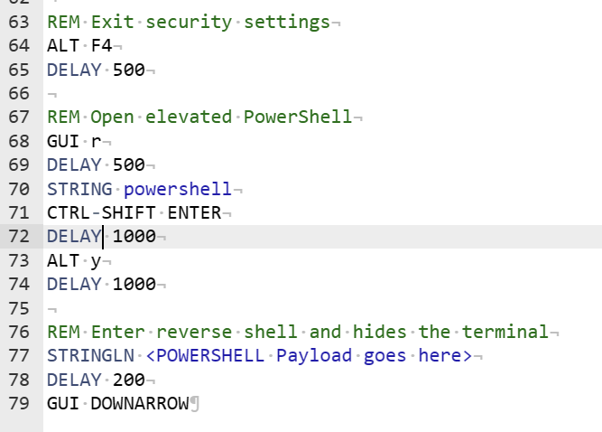
Advance Payload

Slide 9
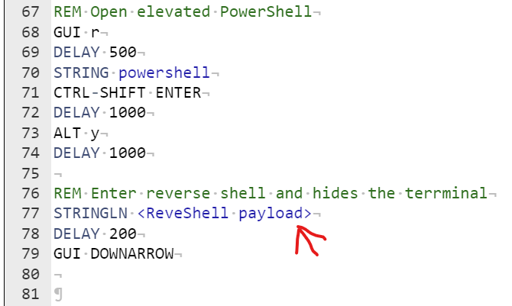
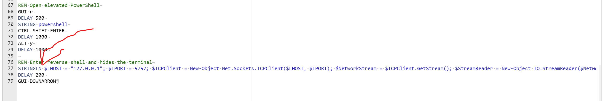
Inserting Payload

Slide 10
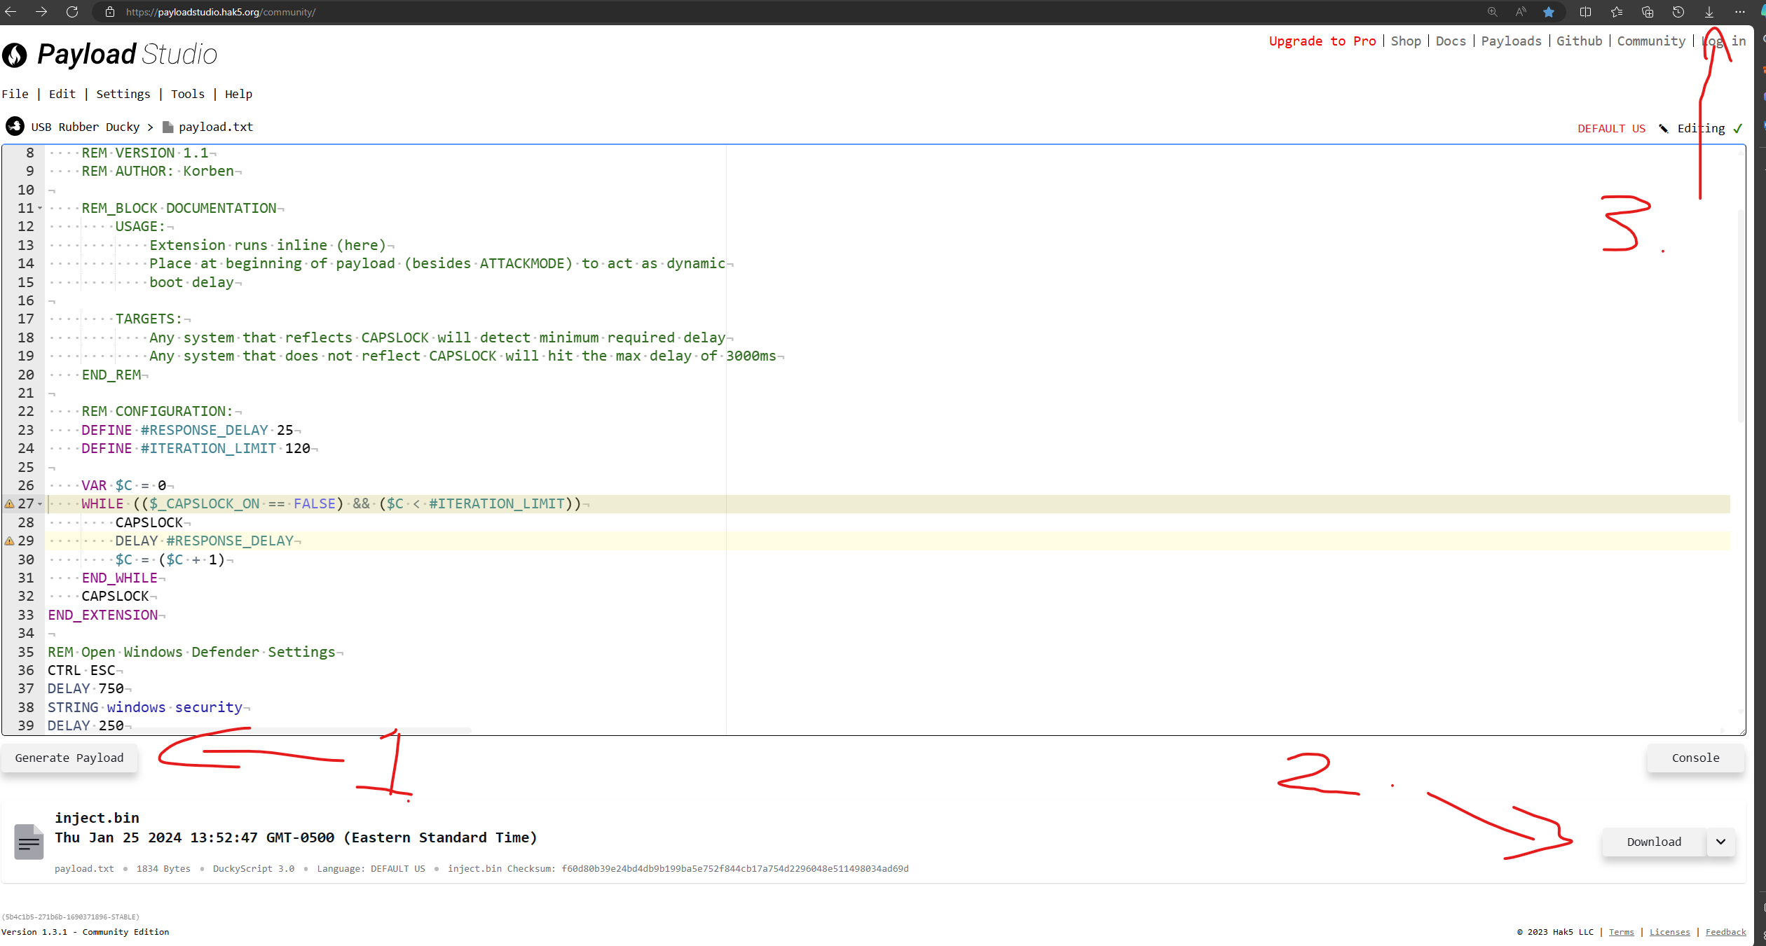

Slide 11
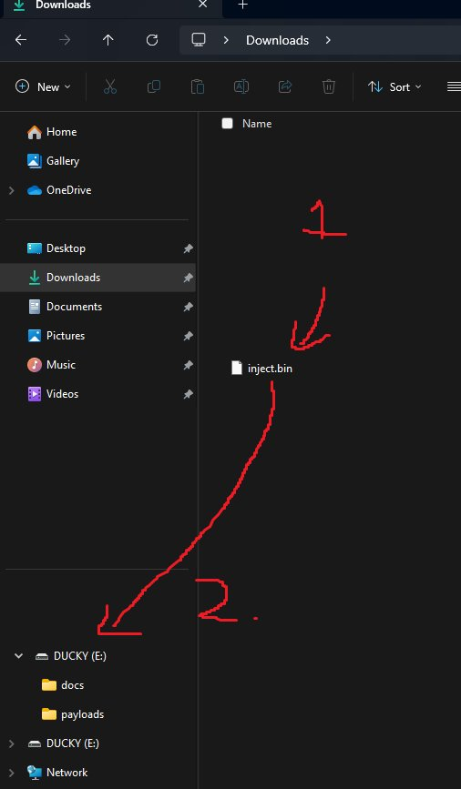
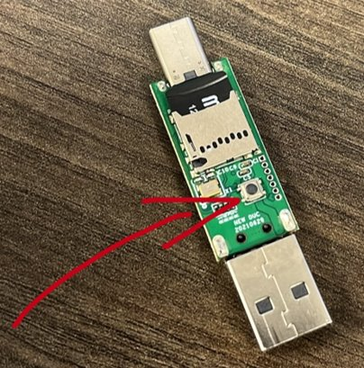
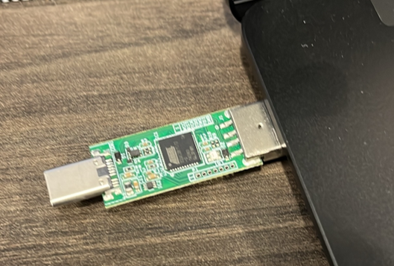
Loading the Payload

Slide 12
Notes & Questions
The computers must be on the same network. Or host the listener on the cloud.
This payload will take about 25 seconds or more, if you have to change the delay for slower computers.

